Slide 1












Community
Connect Us to Loud better
cloudnloud
Join Discord Channel
cloudnloud.com
info@cloudnloud.com

Slide 2














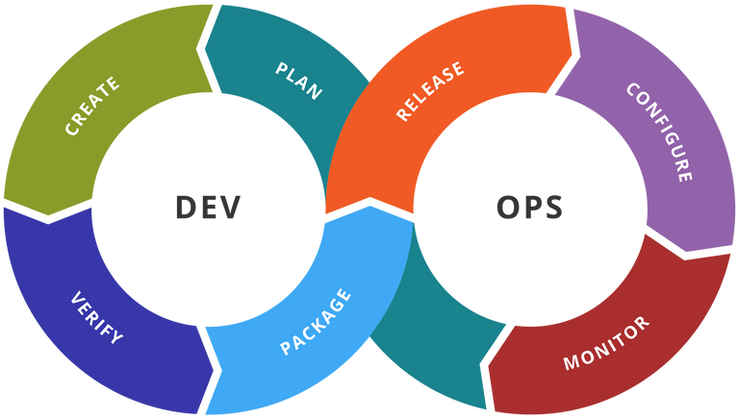

Community

Slide 3





Know your skill(s)
Analyse your expertise level
Create a Learning Path/Goal
Work towards it
Attain the Expert Level & Move on to next level
Networking
Visibility
Consistency
Consistency
Is the
KEY
LinkedIn
Meetup
Webinar
Courses
@kannamgcyber
@cloudnloud
@cloudnloud
info@cloudnloud.com
https://cloudnloud.com
cloudnloud

Slide 4

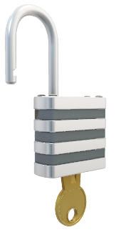
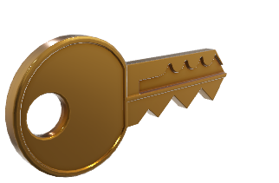
Writing Blogs/Articles
Daily Learning
LinkedIn Posts/Articles
Increasing Followers/Connections
Connecting with Leaders
Success
Leadership
Brand Recognition
CONSISTENCY IS THE KEY FOR UNLOCKING THE ABOVE
@kannamgcyber
@cloudnloud
@cloudnloud
info@cloudnloud.com
https://cloudnloud.com
cloudnloud

Slide 5
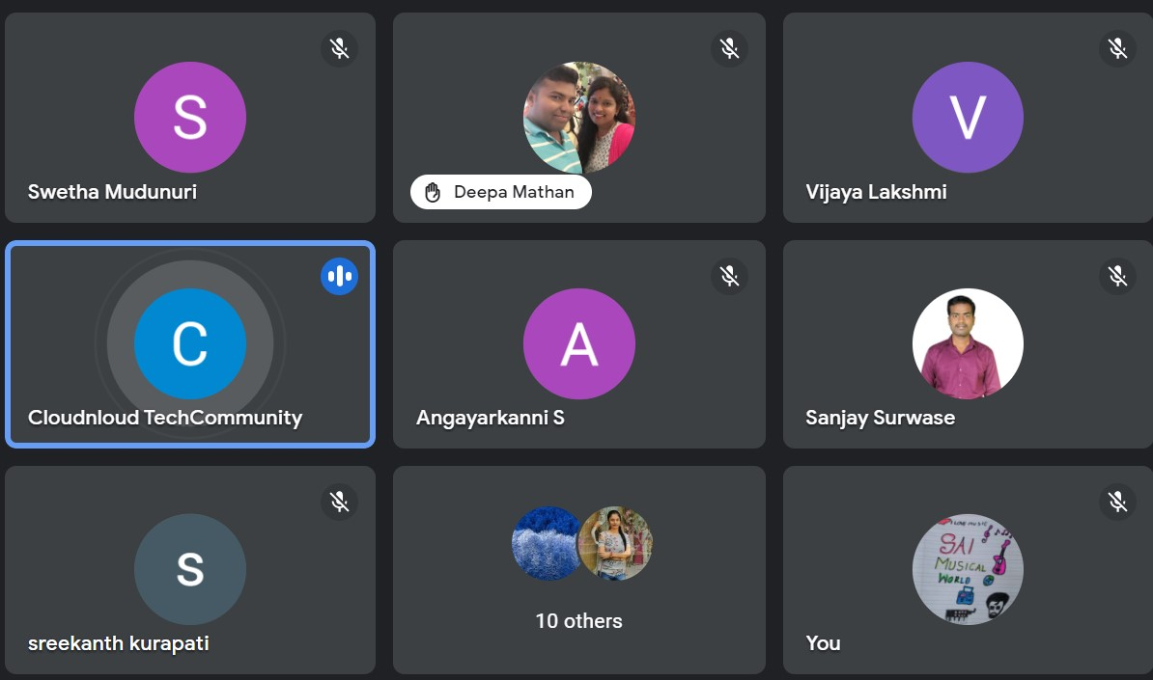
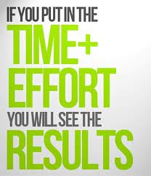
@kannamgcyber
@cloudnloud
@cloudnloud
info@cloudnloud.com
https://cloudnloud.com
cloudnloud

Slide 6


